Slide 1
krypt.semper pi.
krypt. semper pi.
martin boßlet

Slide 2
krypt.semper pi.
whoami
ruby-core
ruby openssl
freelancer

Slide 3

krypt.semper pi.
whoami
germany
ドイツ人

Slide 4
krypt.semper pi.
crypto is hard
暗号は難しい

Slide 5
krypt.semper pi.
u can't touch this
ムリ

Slide 6

krypt.semper pi.
touched crypto
暗号に触れたヒト

Slide 7
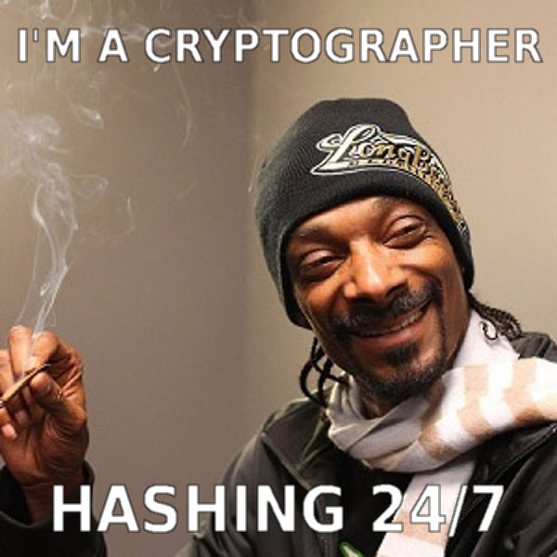
krypt.semper pi.
gets crypto
モノにしたヒト:
なんでもハッシュ！

Slide 8
krypt.semper pi.
so, if crypto is hard
暗号が難しいとして

Slide 9
krypt.semper pi.
do crypto apis have to be, too?
暗号APIも難しい？

Slide 10
krypt.semper pi.
two opposing forces
相反するチカラ

Slide 11
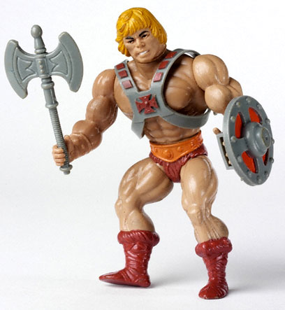
krypt.semper pi.
„when i refactored our login,
i mostly cared about security. what do i care about algorithms? i need my time to work out!“
「ログイン部分をいじる時はセキュリティのことを考えてた。誰がアルゴリズムを気にする？私は自分の問題を解決したいんだ！」

Slide 12
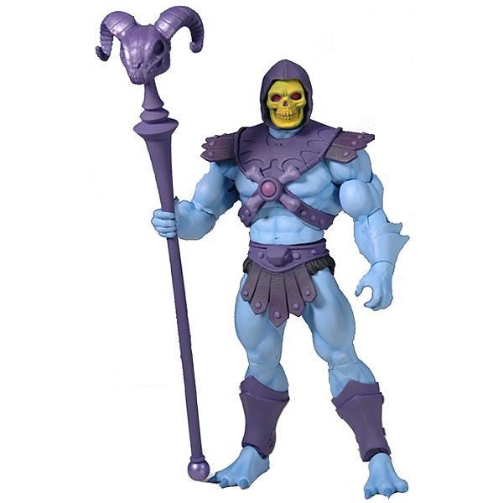
krypt.semper pi.
„i did a lot of ssl pentesting lately.
i need full control of all parameters. and i sure do need my legacy algorithms, dude.“
「私は最近SSL筆記試験を受けた。全てのパラメータの細かな制御が必要。 あと古いアルゴリズムもな」

Slide 13
krypt.semper pi.
everyday development:
日々の開発:

Slide 14
krypt.semper pi.
security sucks
security sucks.
セキュリティなんてくそくらえ

Slide 15
krypt.semper pi.
„oh no, not security again!“
security sucks.
「二度とセキュリティなんて！」

Slide 16

krypt.semper pi.
security is the jar jar binks
of software development
セキュリティはソフトウェア開発の嫌われ者

Slide 17
krypt.semper pi.
it's also a huge pain
security sucks.
巨大な痛み

Slide 18
krypt.semper pi.
that unfortunately cannot be overlooked
security sucks.
残念ながら見逃してもらえない

Slide 19
krypt.semper pi.
and must be dealt with
security sucks.
対処が必要

Slide 20
krypt.semper pi.
security can be a real bitch
security sucks.
セキュリティはビッチになりうる

Slide 21

krypt.semper pi.

Slide 22
krypt.semper pi.
good design
==
making complex things easy
security sucks.
よいデザイン == 難しいことを簡単に

Slide 23
krypt.semper pi.
databases are hard -> active record
security sucks.
データベースは難しい → active record

Slide 24
krypt.semper pi.
threads are hard -> stm, actors
security sucks.
Threadは難しい → STM、アクター

Slide 25
krypt.semper pi.
memory is hard -> gc
security sucks.
メモリ管理は難しい → GC

Slide 26
krypt.semper pi.
don't bother me with details
security sucks.
細かいことで煩わされたくない

Slide 27
krypt.semper pi.
but experts™ need full control
security sucks.
専門家は「全ての制御」をしたい

Slide 28
krypt.semper pi.
conflict
security sucks.
矛盾

Slide 29
krypt.semper pi.
abstraction vs. oversimplification
security sucks.
抽象化 vs 過度の単純化

Slide 30
krypt.semper pi.
there is no golden middle
security sucks.
中庸はない

Slide 31
krypt.semper pi.
if full control is your thing:
「全ての制御」が必要なら:

Slide 32
krypt.semper pi.
openssl
java security api
&
friends

Slide 33
krypt.semper pi.
if all you care about is security by default:
「デフォルトでの安全性」が必要なら:

Slide 34
krypt.semper pi.
keyczar (no friends)
（※Google Security Teamがそういう目的で作ったやつ）

Slide 35
krypt.semper pi.
(maybe (rb)nacl / libsodium)
あとは

Slide 36
krypt.semper pi.
why not just use keyczar and be done with it?
keyczarでやればいいじゃない？

Slide 37
krypt.semper pi.
well, there's the experts™
まあ、「エキスパート」とかいうヤツがいる

Slide 38

krypt.semper pi.
and legacy apps
あとレガシーアプリ

Slide 39
krypt.semper pi.
we need both
両方必要

Slide 40
krypt.semper pi.
full control if needed
必要なら「全ての制御」

Slide 41
krypt.semper pi.
security by default otherwise
そうでなきゃ「デフォルトで安全」

Slide 42

krypt.semper pi.
„sadly we can't have both. or can we?“
哀しいかな両方は無理。だよね？

Slide 43
krypt.semper pi.
revolutionary idea
革新的なアイデア

Slide 44

krypt.semper pi.
両方作ればいいし？

Slide 45
krypt.semper pi.
combine both aspects in one library
両側面を一つのライブラリに

Slide 46
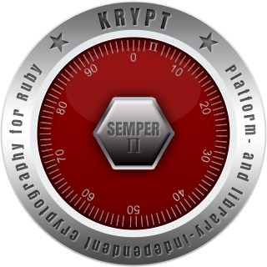
krypt.semper pi.
krypt. semper pi.

Slide 47
krypt.semper pi.
ok, cool, but...

Slide 48

krypt.semper pi.

Slide 49

krypt.semper pi.
who we are
@nahi, @vipulnsward, @abstractj, @qmx, @_emboss_

Slide 50
krypt.semper pi.
will it replace
openssl
java security api
my favorite crypto library
?
「今あるもの」を置き換える？

Slide 51

krypt.semper pi.
we come in peace
平和的に

Slide 52
krypt.semper pi.
krypt first of all is a framework
krypt first of all is a framework
kryptはまず第一にフレームワーク

Slide 53
krypt.semper pi.
using existing libraries
to implement
core cryptography primitives
krypt first of all is a framework
「今あるもの」を使って
暗号の基本要素を作る

Slide 54
krypt.semper pi.
peaceful coexistence
(at least at first)
krypt first of all is a framework
平和的共存 （少なくとも当面は）

Slide 55

krypt.semper pi.
krypt first of all is a framework
expert™
„i see – this is the low-level api that gives me the full control that i so badly need“
「全ての制御」でエキスパート
満足する（※手抜き訳）

Slide 56
krypt.semper pi.
digest
cipher
signature
krypt first of all is a framework
ダイジェスト・暗号化・署名

Slide 57
krypt.semper pi.
krypt adds asn.1 dsl to the mix
krypt first of all is a framework
kryptはASN.1にDSLを持ち込む

Slide 58
krypt.semper pi.
(asn.1 being crypto's lingua franca)
krypt first of all is a framework
（ASN.1は暗号（※フォーマット）の共通言語）

Slide 59
krypt.semper pi.
krypt first of all is a framework
„let's say i write
an app from scratch and all i really care about is the thing being secure – what do i do then?“
アプリを1から作るとして、
セキュアにするにはどうする？

Slide 60
krypt.semper pi.
implement higher-level protocols
using this basis
krypt first of all is a framework
この暗号要素を使って
高レベルプロトコルを実装

Slide 61
krypt.semper pi.
what's the big deal?
krypt first of all is a framework
大事なことはなんでしょう？

Slide 62
krypt.semper pi.
crypto code today
krypt first of all is a framework
今ある暗号コードを見てみよう

Slide 63
krypt.semper pi.
#1 encrypting data
krypt first of all is a framework
#1 データの暗号化

Slide 64
krypt.semper pi.
what it should look like
krypt first of all is a framework
あるべきコード

Slide 65
krypt.semper pi.
krypt first of all is a framework
require 'openssl'
data = 'le secret'
cipher = OpenSSL::Cipher.new('aes-128-cbc')
cipher.encrypt
key = cipher.random_key
iv = cipher.random_iv
enc = cipher.update(data) + cipher.final
decipher = OpenSSL::Cipher::AES.new('aes-128-cbc')
decipher.decrypt
decipher.key = key
decipher.iv = iv
plain = decipher.update(enc) + decipher.final

Slide 66
krypt.semper pi.
what it actually looks like
krypt first of all is a framework
実際に見られるコード

Slide 67
krypt.semper pi.
krypt first of all is a framework
require 'openssl'
data = 'le secret'
key = 'lepasswordlepassword'
cipher = OpenSSL::Cipher.new('AES-128-ECB')
cipher.encrypt
cipher.key = key
enc = cipher.update(data) + cipher.final
decipher = OpenSSL::Cipher::AES.new('AES-128-ECB')
decipher.decrypt
decipher.key = key
plain = decipher.update(enc) + cipher.final

Slide 68
krypt.semper pi.
krypt first of all is a framework
require 'openssl'
data = 'le secret'
key = 'lepasswordlepassword' # fail
cipher = OpenSSL::Cipher.new('AES-128-ECB')
cipher.encrypt
cipher.key = key
enc = cipher.update(data) + cipher.final
decipher = OpenSSL::Cipher::AES.new('AES-128-ECB')
decipher.decrypt
decipher.key = key
plain = decipher.update(enc) + cipher.final

Slide 69
krypt.semper pi.
krypt first of all is a framework
require 'openssl'
data = 'le secret'
key = 'lepasswordlepassword'
cipher = OpenSSL::Cipher.new('AES-128-ECB') # fail
cipher.encrypt
cipher.key = key
enc = cipher.update(data) + cipher.final
decipher = OpenSSL::Cipher::AES.new('AES-128-ECB') # fail
decipher.decrypt
decipher.key = key
plain = decipher.update(enc) + cipher.final

Slide 70
krypt.semper pi.
krypt first of all is a framework
require 'openssl'
data = 'le secret'
key = 'lepasswordlepassword'
cipher = OpenSSL::Cipher.new('AES-128-ECB')
cipher.encrypt
cipher.key = key
# no iv -> fail
enc = cipher.update(data) + cipher.final
decipher = OpenSSL::Cipher::AES.new('AES-128-ECB')
decipher.decrypt
decipher.key = key
# no iv -> fail
plain = decipher.update(enc) + cipher.final

Slide 71
krypt.semper pi.
krypt first of all is a framework
require 'openssl'
data = 'le secret'
key = 'lepasswordlepassword'
cipher = OpenSSL::Cipher.new('AES-128-ECB')
cipher.encrypt # design fail
cipher.key = key
enc = cipher.update(data) + cipher.final
decipher = OpenSSL::Cipher::AES.new('AES-128-ECB')
decipher.decrypt # design fail
decipher.key = key
plain = decipher.update(enc) + cipher.final

Slide 72
krypt.semper pi.
krypt first of all is a framework
require 'openssl'
data = 'le secret'
key = 'lepasswordlepassword'
cipher = OpenSSL::Cipher.new('AES-128-ECB')
cipher.encrypt
cipher.key = key
enc = cipher.update(data) + cipher.final # design fail
decipher = OpenSSL::Cipher::AES.new('AES-128-ECB')
decipher.decrypt
decipher.key = key
plain = decipher.update(enc) + cipher.final # design fail

Slide 73
krypt.semper pi.
#2 pbkdf2 password hash
krypt first of all is a framework
#2 パスワードハッシュ

Slide 74
krypt.semper pi.
what it should look like
krypt first of all is a framework
あるべきコード

Slide 75
krypt.semper pi.
krypt first of all is a framework
require 'openssl'
pass = 'le secret'
salt = OpenSSL::Random.random_bytes(16)
iter = 20000
len = OpenSSL::Digest::SHA1.new.digest_len # 20
hash = OpenSSL::PKCS5.pbkdf2_hmac_sha1(pass, salt, iter, len)

Slide 76
krypt.semper pi.
what it actually looks like
krypt first of all is a framework
実際に見られるコード

Slide 77
krypt.semper pi.
krypt first of all is a framework
require 'openssl'
pass = 'le secret'
salt = pass
iter = 10
len = password.size
hash = OpenSSL::PKCS5.pbkdf2_hmac_sha1(pass, salt, iter, len)

Slide 78
krypt.semper pi.
krypt first of all is a framework
require 'openssl'
pass = 'le secret'
salt = pass # fail
iter = 10
len = password.size
hash = OpenSSL::PKCS5.pbkdf2_hmac_sha1(pass, salt, iter, len)

Slide 79
krypt.semper pi.
krypt first of all is a framework
require 'openssl'
pass = 'le secret'
salt = pass
iter = 10 # fail
len = password.size
hash = OpenSSL::PKCS5.pbkdf2_hmac_sha1(pass, salt, iter, len)

Slide 80
krypt.semper pi.
krypt first of all is a framework
require 'openssl'
pass = 'le secret'
salt = pass
iter = 10
len = password.size # fail
hash = OpenSSL::PKCS5.pbkdf2_hmac_sha1(pass, salt, iter, len)

Slide 81
krypt.semper pi.
krypt first of all is a framework
require 'openssl'
pass = 'le secret'
salt = pass
iter = 10
len = password.size
# design fail
hash = OpenSSL::PKCS5.pbkdf2_hmac_sha1(pass, salt, iter, len)

Slide 82
krypt.semper pi.
krypt first of all is a framework
require 'openssl'
pass = 'le secret'
salt = pass
iter = 10
len = password.size
o_O
hash = OpenSSL::PKCS5.pbkdf2_hmac_sha1(pass, salt, iter, len)

Slide 83
krypt.semper pi.
what it actually actually looks like
krypt first of all is a framework
とかいって本当の実際は

Slide 84
krypt.semper pi.
krypt first of all is a framework
require 'openssl'
pass = 'le secret'
salt = pass
digest = OpenSSL::Digest::MD5.new
hash = digest.digest(salt + pass)
（※ストレッチしないただのハッシュw）

Slide 85

krypt.semper pi.

Slide 86
krypt.semper pi.
#3 certificate validation
krypt first of all is a framework
#3 証明書検証

Slide 87
krypt.semper pi.
what it should look like
krypt first of all is a framework
あるべきコード

Slide 88
krypt.semper pi.
krypt first of all is a framework
require 'openssl'
store = OpenSSL::X509::Store.new
store.set_default_paths
oh, you know what, i don't
have the time for this...
（わかるよね、時間ないし。。。）

Slide 89
krypt.semper pi.
almost impossible to do it correct™
krypt first of all is a framework
「正しく」やるのはほぼ無理

Slide 90
krypt.semper pi.
online revocation checks
krypt first of all is a framework
オンラインでの失効確認

Slide 91
krypt.semper pi.
openssl refuses to have dependencies
krypt first of all is a framework
opensslは依存ライブラリを許さない

Slide 92
krypt.semper pi.
relic of bygone times before
dependency management tools
krypt first of all is a framework
依存管理ツールがなかった頃の遺物

Slide 93
krypt.semper pi.
we're left with half-assed validation
krypt first of all is a framework
不完全な証明書検証

Slide 94
krypt.semper pi.
krypto code tomorrow
krypt first of all is a framework
これからのkryptoコード

Slide 95
krypt.semper pi.
what it should actually look like
krypt first of all is a framework
あるべきコード

Slide 96
krypt.semper pi.
#1 encrypting data
krypt first of all is a framework
#1 データ暗号化

Slide 97
krypt.semper pi.
krypt first of all is a framework
require 'krypt'
data = 'le secret'
encrypter = Krypt::Encrypter.new
key = encrypter.generate_key
enc = encrypter.encrypt(data)
decrypter = Krypt::Decrypter.new
decrypter.key = key
plain = decrypter.decrypt(data)

Slide 98
krypt.semper pi.
#2 password hash
krypt first of all is a framework
#2 パスワードハッシュ

Slide 99
krypt.semper pi.
krypt first of all is a framework
require 'krypt'
pass = 'le secret'
hash = Krypt::PasswordHash.hash(pass)
begin
Krypt::PasswordHash.verify(hash, pass)
rescue Krypt::PasswordHash::InvalidPassword
# react
end
#swell

Slide 100
krypt.semper pi.
#3 certificate validation
krypt first of all is a framework
#3 証明書検証

Slide 101
krypt.semper pi.
krypt first of all is a framework
require 'krypt'
certificate = Krypt::X509::Certificate.new(bytes)
begin
certificate.verify
rescue Krypt::X509::VerificationError
# react
end
#swell

Slide 102
krypt.semper pi.
don't bother me with details
security sucks.
細かいことに煩わされたくない

Slide 103
krypt.semper pi.
security by default
security sucks.
デフォルトで安全

Slide 104
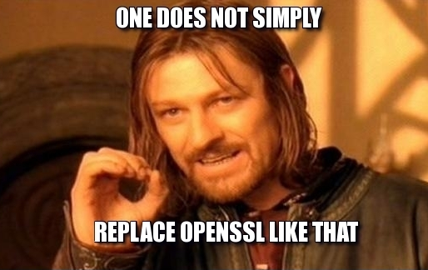
krypt.semper pi.
security sucks.

Slide 105

krypt.semper pi.
yes we can

Slide 106
krypt.semper pi.
use protocols
security sucks.

Slide 107
krypt.semper pi.
moar advantages:
security sucks.
更なる利点:

Slide 108
krypt.semper pi.
moar tests
security sucks.
より多くのテスト

Slide 109
krypt.semper pi.
rspec
FuzzBert
security sucks.

Slide 110
krypt.semper pi.
moar docs (non-expert™)
security sucks.
より多くのドキュメント
（非エキスパート向け）

Slide 111
krypt.semper pi.
moar ruby
security sucks.
より多くのruby

Slide 112
krypt.semper pi.
easier to understand & maintain
security sucks.
理解・管理し易い

Slide 113
krypt.semper pi.
minimal portion of native code
krypt first of all is a framework
ネイティブコードは最小限

Slide 114
krypt.semper pi.
using whatever library is available
in the background
krypt first of all is a framework
基礎として使えるライブラリなら何でも使う

Slide 115
krypt.semper pi.
diversity™
security sucks.
「多様性」

Slide 116
krypt.semper pi.
the rest is plain ruby
krypt first of all is a framework
後はただのruby

Slide 117
krypt.semper pi.
„why should anyone care?“
krypt first of all is a framework
「誰が気にする？」

Slide 118
krypt.semper pi.
write once, run anywhere™
krypt first of all is a framework
2
「一度書けばどこでも動く」

Slide 119
krypt.semper pi.
run on all rubies
security sucks.
全てのruby実装で動作

Slide 120
krypt.semper pi.
https
krypt first of all is a framework

Slide 121
krypt.semper pi.
if https doesn't work,
ruby doesn't work
krypt first of all is a framework
https使えなきゃruby使えない

Slide 122
krypt.semper pi.
(https://rubygems.org, anyone?)
krypt first of all is a framework

Slide 123
krypt.semper pi.
openssl isn't available everywhere
krypt first of all is a framework
opensslはどこでも使えるわけじゃない

Slide 124
krypt.semper pi.
c (or java) extensions are not the answer
krypt first of all is a framework
CやJava拡張は解ではない

Slide 125
krypt.semper pi.
only ruby runs everywhere
krypt first of all is a framework
rubyだけがどこでも動く

Slide 126
krypt.semper pi.
this is part of java's success
krypt first of all is a framework
Javaの成功の一つ

Slide 127
krypt.semper pi.
provider (native code)
krypt (ruby code)
krypt first of all is a framework
ffi / native code
ネイティブコードによるプロバイダを使う

Slide 128


krypt.semper pi.
„what's yours is mine!“
「お前のものは俺のもの」

Slide 129
krypt.semper pi.
use openssl on jruby
krypt first of all is a framework
JRubyでopensslを使う

Slide 130
krypt.semper pi.
benefit from fips validation
krypt first of all is a framework
FIPS認証の恩恵

Slide 131
krypt.semper pi.
w/o changing any of the code
krypt first of all is a framework
コード書き換えなしに

Slide 132


krypt.semper pi.
le demo
krypt first of all is a framework

Slide 133
krypt.semper pi.
same code runs on all platforms
krypt first of all is a framework
同じコードが全てのプラットフォームで動く

Slide 134
krypt.semper pi.
using different parts to get there
krypt first of all is a framework
異なるパーツを使って

Slide 135
krypt.semper pi.
write once, run anywhere™
krypt first of all is a framework
2

Slide 136
krypt.semper pi.
future: all-ruby provider
krypt first of all is a framework
将来: rubyで書いたプロバイダ

Slide 137
krypt.semper pi.
„if it runs ruby, it runs krypt“
krypt first of all is a framework
「rubyが動くならkryptが動く」

Slide 138
krypt.semper pi.
think:
webrick
vs.
thin, unicorn, puma, torquebox, ...
krypt first of all is a framework

Slide 139
krypt.semper pi.
off-topic: other programming langs
krypt first of all is a framework
他のプログラミング言語では？

Slide 140
krypt.semper pi.
c-based: tightly coupled to openssl
krypt first of all is a framework
Cベースの言語: openssl依存

Slide 141
krypt.semper pi.
write once, run anywhere™
krypt first of all is a framework
2
aka: „write many times, run nowhere“

Slide 142
krypt.semper pi.
java-based:
tightly coupled to java security api
or bouncy castle
krypt first of all is a framework
Javaベースの言語: JavaのAPI、
もしくはBouncy Castleライブラリ

Slide 143
krypt.semper pi.
write once, run anywhere™
krypt first of all is a framework
2

Slide 144
krypt.semper pi.
but:
no c libraries
expert™ api only
krypt first of all is a framework
しかし: Cライブラリは使えない
「エキスパート」向け

Slide 145
krypt.semper pi.
why not give those guys a break, too?
krypt first of all is a framework
彼らにも休息を？

Slide 146
krypt.semper pi.
make krypt a full-blown c & java lib
krypt first of all is a framework
kryptをCおよびJavaライブラリとしても提供

Slide 147
krypt.semper pi.
blueprint for jvm and c-based languages
krypt first of all is a framework
JVMおよびCベース言語なら
使えるように

Slide 148
krypt.semper pi.
write once, run anywhere™
krypt first of all is a framework
2

Slide 149

krypt.semper pi.
krypt all the things
どこでもkrypt

Slide 150
krypt.semper pi.
once we take over the world
krypt first of all is a framework
もし成功したら

Slide 151
krypt.semper pi.
we make sure to be gentle
to the people in this room
krypt first of all is a framework
この部屋にいる人たちに
寛大であります（？）

Slide 152
krypt.semper pi.
if nobody picks up the idea?
krypt first of all is a framework
誰も見向きもしなかったら？

Slide 153
krypt.semper pi.

Slide 154

krypt.semper pi.
„at least we'll have
flawless design“
「少なくとも我々は
完璧なデザインを手に入れるでしょう」

Slide 155
krypt.semper pi.
is it any good?
krypt first of all is a framework
役に立つ？

Slide 156
krypt.semper pi.
participating in jruby gsoc '12 & '13
krypt first of all is a framework
JRubyのGoogle Summer of Codeに参加

Slide 157
krypt.semper pi.
https://github.com/jruby/jruby/commit/cc9acbaf2
„Incorporate Krypt and wire it up for OpenSSL::PKCS5.“
krypt first of all is a framework
「kryptを導入してPKCS5で使う」

Slide 158

krypt.semper pi.
krypt first of all is a framework

Slide 159

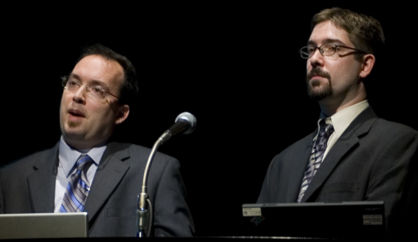
krypt.semper pi.
„thank you!!!“

Slide 160
krypt.semper pi.
still a long road ahead of us
krypt first of all is a framework
まだまだ長い道のり

Slide 161
krypt.semper pi.
plan: krypt as default crypto library
plan: krypt as default crypto library
krypt first of all is a framework
計画: kryptをデフォルト（ruby標準）の
暗号ライブラリに

Slide 162
krypt.semper pi.
sneaky plan:
use openssl shim for the interim period
krypt first of all is a framework
秘密の計画:
当面はopensslをラップして使う

Slide 163
krypt.semper pi.
https://github.com/krypt/krypt-ossl
krypt first of all is a framework

Slide 164
krypt.semper pi.
thank you, @nahi
krypt first of all is a framework

Slide 165
krypt.semper pi.
thank you
https://github.com/krypt
http://martinbosslet.de
martin.bosslet@gmail.com
@_emboss_
krypt first of all is a framework

